Slide 1
SOBEL FILTER IN
DIGITAL IMAGES PROCESSING
Notes:
Today I’ll be presenting on FUNDAMENTALS OF SPACTIAL FILLTERING
– a fundamental technique used to enhance image quality before deeper analysis.

Slide 2

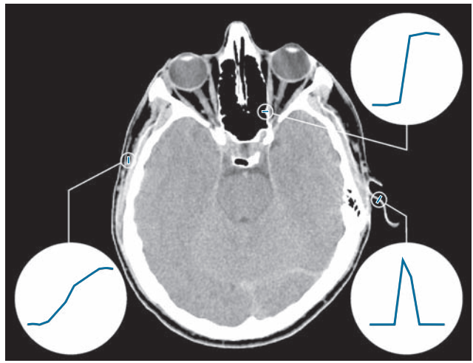
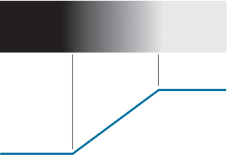

EDGE DETECTION
What is Edge?
An edge is a boundary or a significant change in intensity between adjacent pixcel
Type of Edge:
Step Edge:
Ramp Edge:
Roof Edge:
Notes:
In image processing and computer vision, an edge is a boundary or a significant change in intensity (brightness or color) between adjacent pixels. Edges often represent object boundaries, texture changes, or surface orientation changes, and they are critical for analyzing the structure and shapes in an image.
Edges can be classified based on the intensity profile—how the brightness changes across the edge. The common types are:
Step edge: Sudden and consistent change in intensity. Appears as a sharp transition.
Ramp Edge: Gradual change in intensity over a wider area. In real situations, edges are more closely modeled as having an intensity ramp profile
Intensity rises to a peak and falls back. Often seen in thin lines or textures. Roof edges are models of lines through a region,

Slide 3
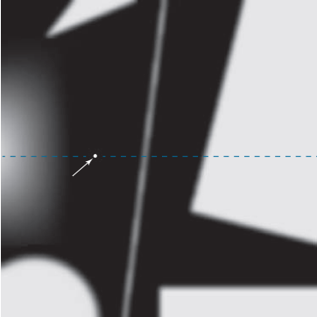
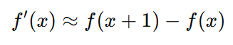
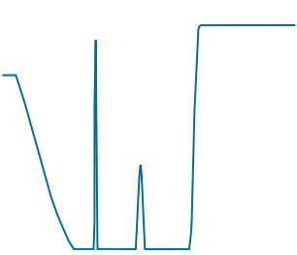
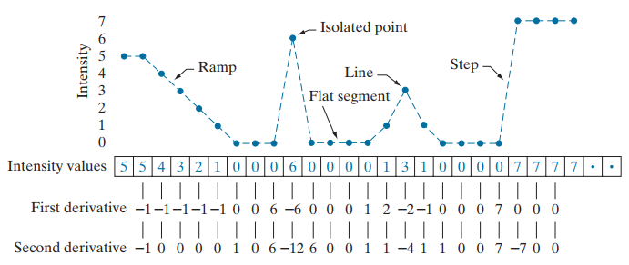
Using derivative in detecting edge
In image processing, the derivative is approximated by the difference between neighboring pixels.
Example in 1D, first-order derivative:
If pixel values don't change → derivative is close to 0.
If pixel values change suddenly → derivative is large → likely an edge.
Notes:
edges are locations in an image where the intensity changes rapidly, and the derivative illustrates how fast a value changes. It measures exactly that

Slide 4
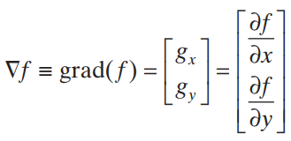
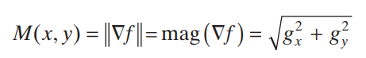
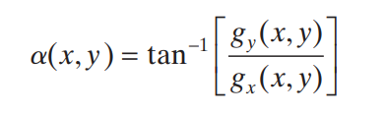
Gradient
In 2-D, First derivatives in image processing are implemented using the magnitude of the gradient. The gradient of an image f at coordinates (x , y) is a vector which defined as the two - dimensional column vector
Gradient vector
The partial derivative to the horizontal direction 𝑥.
The partial derivative to the vertical direction y.
Base on the formula, we evaluate the magnitude and the direction of gradient vector
The magnitude of the gradient shows how strong the change is
grad(f)
$$g_{y}$$
The direction shows where the change is happening fastest.
α
$$g_{x}$$

Slide 5
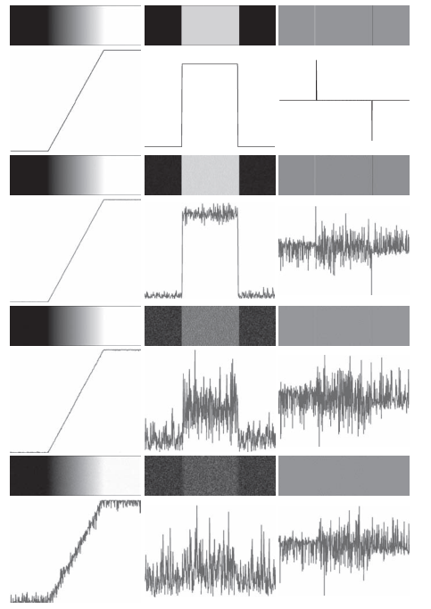
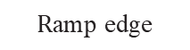
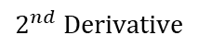
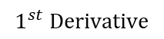
Sensitivity of derivatives to noise
Standard deviations of 0.0
Standard deviations of 0.1
Standard deviations of 1.0
Standard deviations of 10.0
$$\text{R}\text{amp} \text{edge}$$
$$1^{st} Derivative$$
$$2^{nd} Derivative$$
Notes:
These examples are illustrations of the sensitivity of derivatives to noise.
First column: 8-bit images with values in the range [0, 255], and intensity profiles of a ramp edge corrupted by Gaussian noise of zero mean and standard deviations of 0.0 0.1 1.0, and 10.0 intensity levels, respectively. Second column: First-derivative images and intensity profiles. Third column: Second-derivative images and intensity profiles.
The noise is almost visually undetectable in the images on the left column.
As we move down the center column, the derivatives become increasingly different from the noiseless case.
In fact, it would be difficult to associate the last profile in the center column with the first derivative of a ramp edge. As expected, the second derivative is even more sensitive to noise. The only noisy second derivative image that barely resembles the noiseless case corresponds to noise with a standard deviation of 0.1. The remaining second-derivative images and profiles clearly illustrate that it would be difficult indeed to detect their positive and negative components.
We need to reduce the noise if we want to detect the edge by using derivative

Slide 6
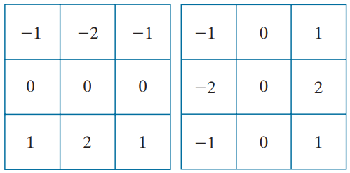
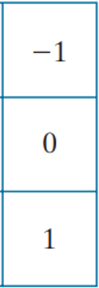
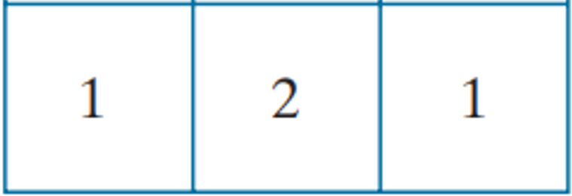
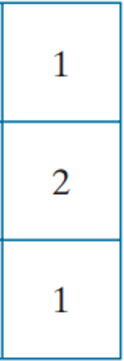
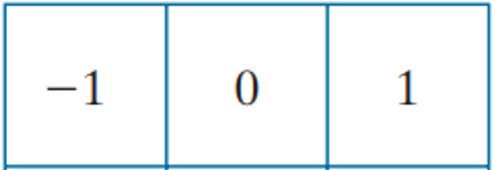
Sobel filter kernel
The Sobel filter works by computing the first derivative of image intensity to detect edges. It combines:
Image smoothing to reduce noise
The first derivative of image intensity to detect edges.
Discrete central difference mask detect horizontal edges
x Axis
x
Weighted smoothing
y Axis
x
Discrete central difference mask detect vertical edges

Slide 7
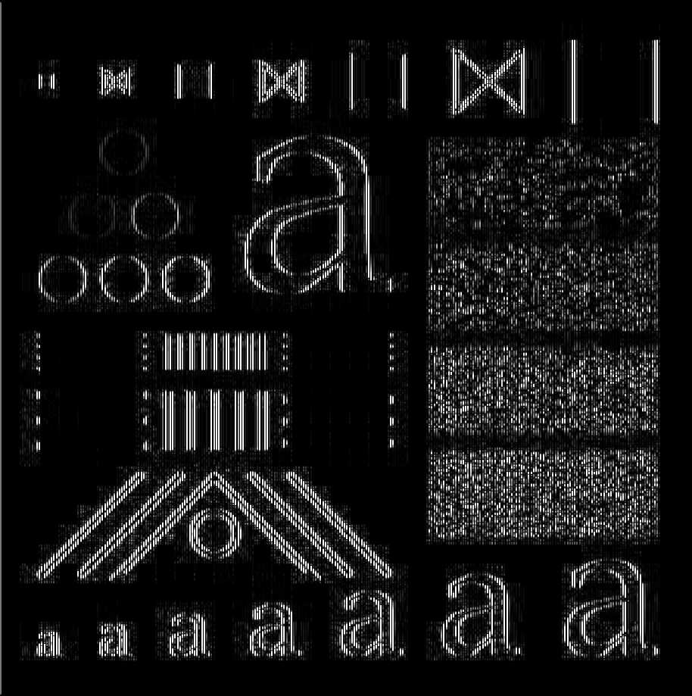


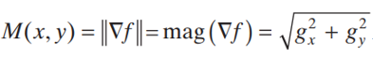
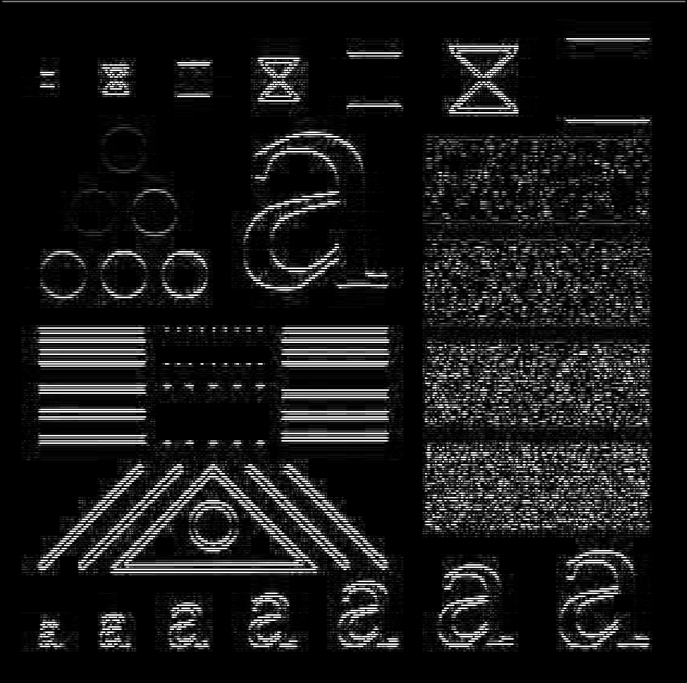
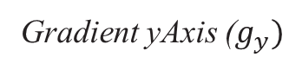
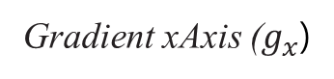
Apply Sobel filter Process
Gradient xAxis ($g_{x}$)
Sobel kernel xAxis
Correlation
Sobel kernel yAxis
Correlation
Original Image
Gradient yAxis ($g_{y})$

Slide 8
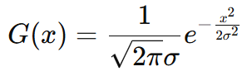
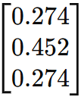
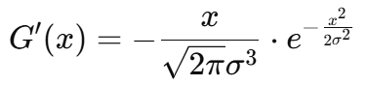
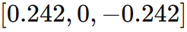
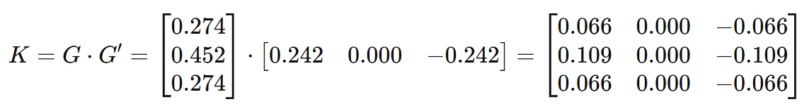
Sobel Filter Program
Step 1: Create Sobel Kernel
Create a 1-D Gaussian kernel for Gaussian smoothing (used instead of weighted smoothing): Use default sigma = 1.0
Create a 1-D Gaussian derivative kernel (used instead of the simple derivative filter): Use default sigma = 1.0
x is the distance from the center
σ is the standard deviation (controls the spread or "blurriness").
Calculate the outer product of two kernels to create the Sobel kernel.
yAxis Sobel Kernel

Slide 9
Sobel Filter Program
Step 2: Perform a 2D convolution between the image and the kernel.
Step 3: Compute the gradient magnitude
Step 4: Normalize the result to the range [0, 255] and convert it to the CV_8UC1 type.

Slide 10
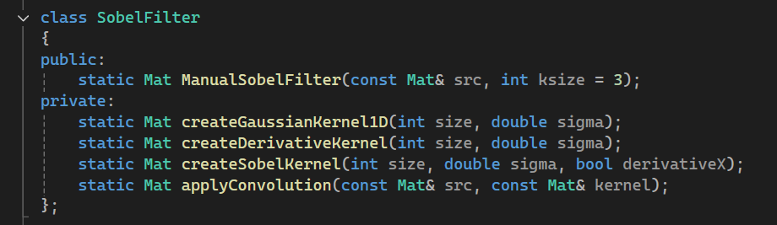
Sobel Filter Program
createGaussianKernel1D(): Create a 1-D Gaussian kernel
createDerivativeKernel(): Create a 1-D Gaussian derivative kernel
createSobelKernel(): Create the Sobel kernels along the x-axis and y-axis
applyConvolution(): Perform a 2D convolution between the image and 2 sobel kernel.
ManualSobelFilter(): Compute the gradient magnitude, Normalize the gradient image and save the result

Slide 11
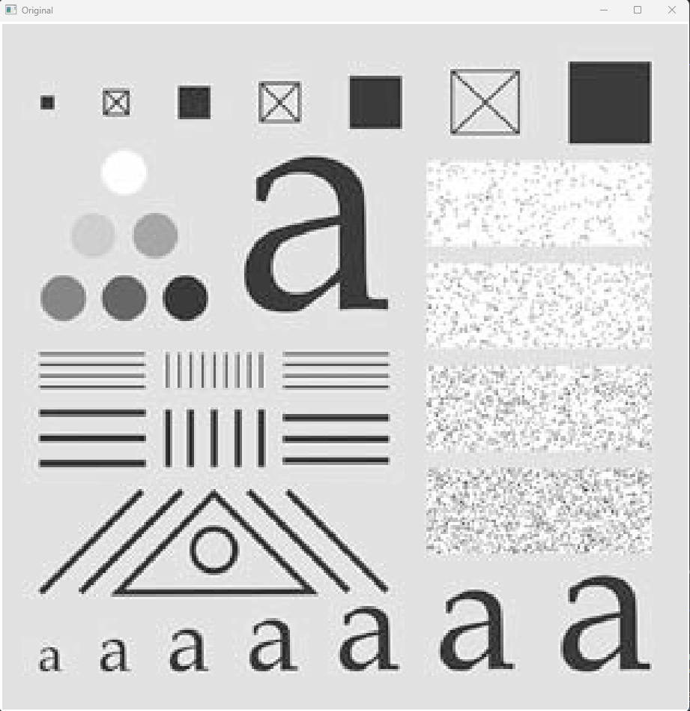

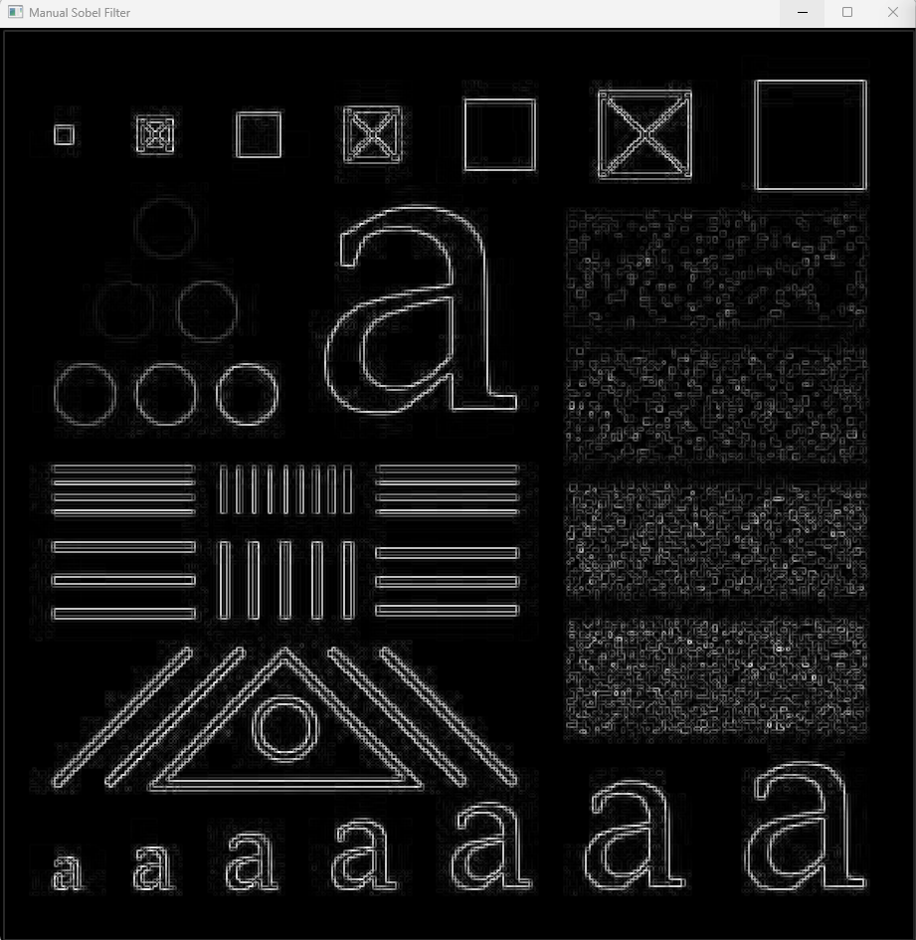
Result
Original Image
OpenCV Sobel filter Size 3x3
Manual Sobel filter Size 3x3

Slide 12
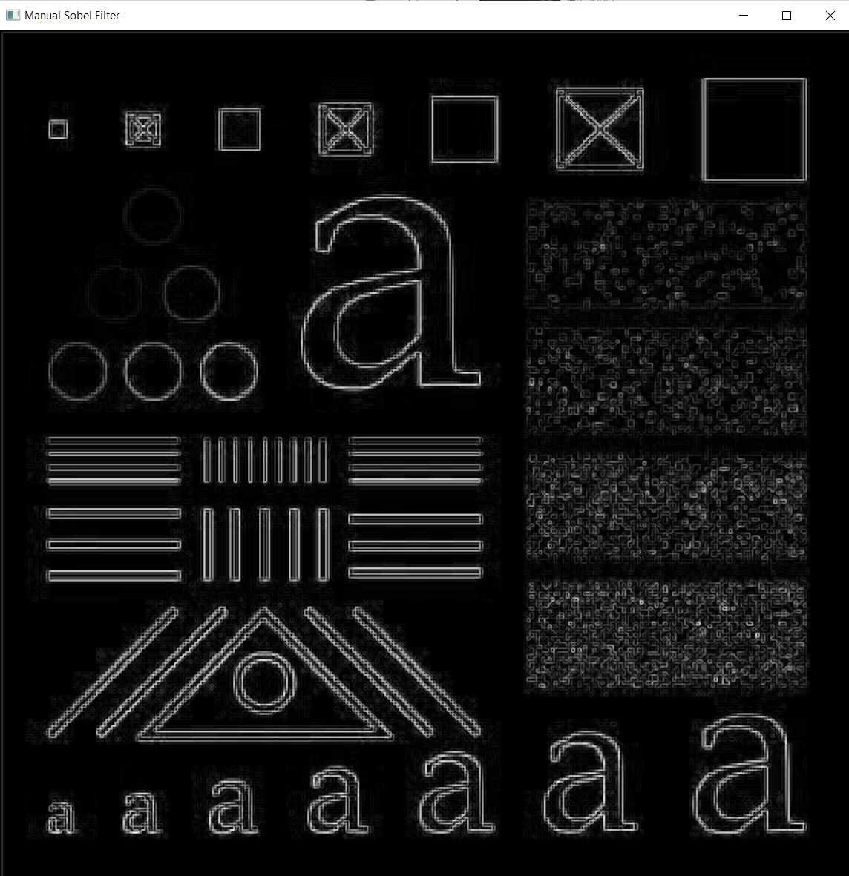

Result
Manual Sobel filter Size 3x3
Manual Sobel filter Size 9x9

Slide 13

Result
OpenCV Sobel filter Size 3x3
Manual Sobel filter Size 3x3, sigma = 1.0
Manual Sobel filter Size 3x3, sigma = 2.0

Slide 14
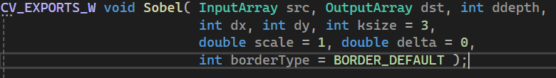

Slide 15
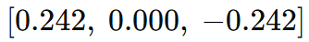
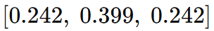
The Sobel filter works by computing the first derivative of image intensity to detect edges.
Image smoothing for noise reduction. Detection of edge points.

Slide 16
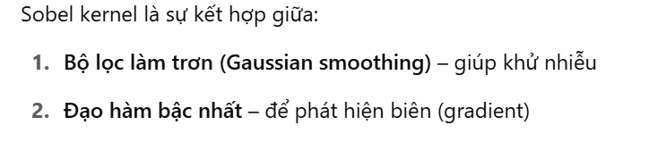
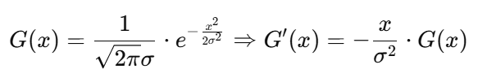
Bộ lọc Gaussian theo một chiều (smoothing)
Bộ lọc đạo hàm theo chiều còn lại

